Slide 1
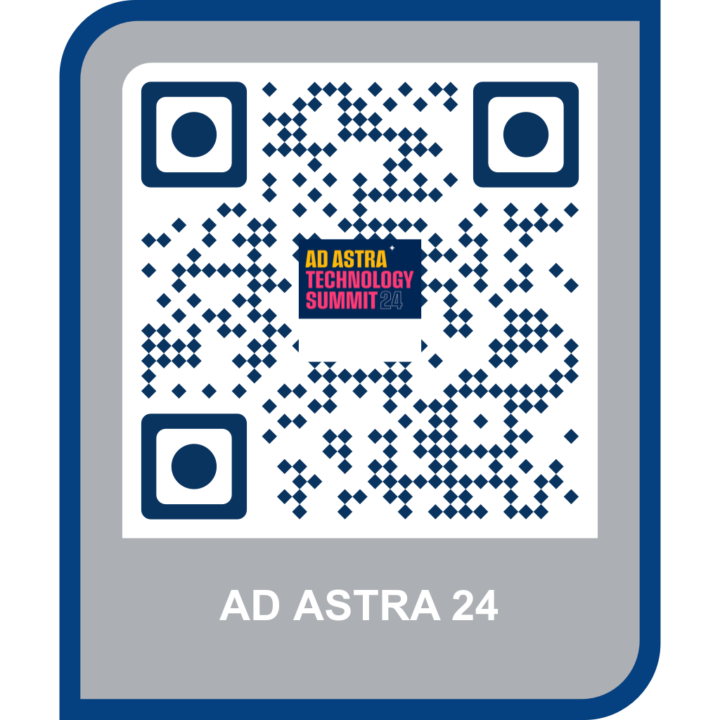
Data in Action: AI Tools & Practical Demos
Justin B. Keeler, PhD

Slide 2
Simple and Useful Applications
Short Discussion on LLM Tools
Analyzing Wichita Riverfest 2024* (https://chatgpt.com/)
Analyzing Titanic Data (https://chatgpt.com)
Promotional/Training Videos (https://invideo.io)
Copyright Your Own Music (https://suno.com)
Time Permitting…Tex-Mex Restaurant Decision
Brief Data Collection (https://www.socrative.com/)
Analyze/Interpret/Visualize in ChatGPT
*Fictious Data

Slide 3
Let’s Begin…

Slide 4
LLM Tools
OpenAI’s ChatGPT (https://chatgpt.com/)
Anthropic’s Claude 3.5 (https://www.anthropic.com/claude)
Google’s Gemini (https://gemini.google.com/app)
Microsoft’s Copilot (https://copilot.microsoft.com/)
X’s Grok-2 (https://x.ai/)

Slide 5
Our First Analysis!

Slide 6
2024 Wichita Riverfest Data*
Data Description:
Data URL: https://bit.ly/aa24-data1
beer_drinking | No = No beer drinking, Lite = 1-2 beers, Heavy = 8-10 beers
ticket_purchases | Number of tickets purchased for rides at the festival
food_purchases | Dollar amount spent on food
festival_attendance | Number of days attended from May 31, 2024 to June 8, 2024
concert_attendance | Number of concerts attended
ess_social_connectedness | Continuous, higher = increased social connectedness (0-1)
ess_social_enjoyment | Continuous, higher = increased social enjoyment (0-1)
ess_shared_experience | Continuous, higher = increased shared experience (0-1)
gender | Male, Female
age | Age

Slide 7
Applied Practice Questions
Customer Engagement: What factors (age, gender, festival attendance) influence how much customers spend on tickets and food at concerts?
Market Segmentation: How can you segment concert attendees based on beer consumption, social enjoyment, and festival participation?
Sales Optimization: Which age group spends the most on food and beverages at events, and how can promotions be tailored to this group?
Customer Loyalty: Does higher social enjoyment at festivals correlate with repeat attendance?
Demographic Insights: How do gender and age affect beer drinking habits at concerts?

Slide 8
Recommend/Suggested AI Prompting
Customer Engagement: “Analyze spending on tickets and food by age, gender, and festival attendance.”
Market Segmentation: “Group attendees by beer consumption, social enjoyment, and festival participation. What are the patterns?”
Sales Optimization: “Examine which age group spends the most on food/beverages. What promotions could target them?”
Customer Loyalty: “Investigate whether higher social enjoyment at festivals correlates with repeat attendance.”
Demographic Insights: “Compare beer drinking habits by age and gender to understand key demographic trends.”

Slide 9
Our Second Analysis!

Slide 10
Titanic Data
Data Description:
Data URL: https://bit.ly/aa24-data2
PassengerID | Index of passenger
Survived | 0 = No, 1 = Yes
Pclass | Ticket class: 1 = 1st, 2 = 2nd, 3 = 3rd
Sex | Female, Male (String)
Age | Age in years
Sibsp | # of siblings & spouse aboard the Titanic
Parch | # of parents & children aboard the Titanic (family size)
Ticket | Ticket number
Fare | Passenger fare in $s
Cabin | Cabin number
Embarked | Port of Embarkation: C = Cherbourg, Q = Queenstown, S = Southampton

Slide 11
Applied Practice Questions
Customer Segmentation: Based on class, age, and gender, how would you segment passengers for a potential luxury cruise line? What are the key characteristics?
Risk Analysis: What factors (e.g., age, ticket class) increases the likelihood of survival? How could these insights be used to improve emergency preparedness in modern transportation?
Predictive Modeling: Can you predict which passengers are more likely to survive using a combination of factors like age, gender, and class?
Pricing Strategy: Analyze how class and fare paid relate to survival rates. What can modern businesses learn about pricing strategy for different customer demographics?
Social Influence: Investigate the survival rates by gender and age groups. How can these findings inform modern-day customer service strategies regarding preferential treatment or targeted services?

Slide 12
Recommend/Suggested AI Prompting
Customer Segmentation: “Group passengers by age, class, and gender. What are the common characteristics within each group?”
Risk Analysis: “Analyze the relationship between passenger class, age, gender, and survival rates. What factors seem to increase survival odds?”
Predictive Modeling: “Build a predictive model using passenger class, gender, and age to predict survival. What features are most influential?”
Pricing Strategy: “Examine how ticket prices correlate with survival and class. What insights can be drawn regarding pricing strategies for different customer segments?”
Social Influence: “Compare survival rates by gender and age. How could these findings inform customer service strategies targeting different demographics?”

Slide 13
Promotional/Training Video

Slide 14
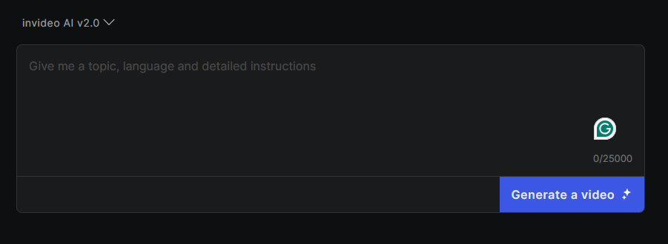
Video Production (istock images)
invideo.io (https://invideo.io)
One of first platforms to leverage user inputs to craft videos with istock pictures/videos (royalty free).
Prompt interface

Slide 15
Applying AI Video in Practice
Video in Practice Questions:
How do you think AI-generated video can enhance customer engagement and communication in business operations?
What challenges or ethical considerations do you anticipate when integrating AI-generated videos into your marketing/training practices?
In what ways could AI-generated videos streamline content creation for your teams, and what impact might this have on the creative process?

Slide 16
The Next Grammy

Slide 17
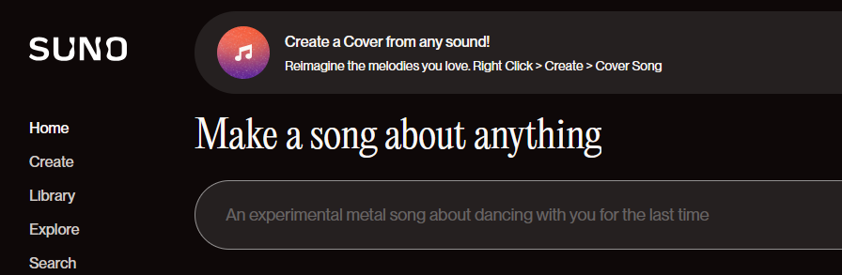
The Musical Arts…Digitalized or Not?
Suno (https://suno.com)
Currently in legal dispute over copyright…admitted to training models on artist’s music but has a strong defense as to all AI generated music is not a duplicate of an artist.
Prompt interface

Slide 18
Applying AI Music in Practice
Music in Practice Questions:
How do you think AI-generated music could impact creative industries, such as marketing, advertising, or content creation?
What role do you think AI-generated music could play in enhancing user experience, such as apps, games, or virtual environments?
What ethical concerns or challenges might arise when using AI-generated music in professional settings i.e. copyright, ownership, and artistic credit?

Slide 19
Almost finished

Slide 20
In summary…
Different LLMs were discussed
We analyzed two data files (must be CSV)
Demonstrated how to make a video
Showcased music production

Slide 21
That’s all folks!

Slide 22
Questions?
Contact Me:
justin.keeler@wichita.edu

